Slide 1
Payment Modernization

Slide 2
What is Payment Modernization?
Payment Modernization allows USPS Customers to securely pay for products and services with ACH Debit or Trust payment methods using their online Enterprise Payment Account.
Current State
Future State
Customers use patchwork of disparate, aging payment systems
Single, Secure, Self-Service Online Account/Payment Management
Modernize
USPS stores customers’ bank account information, incurring risk of data breach
Tokenize bank account information to remove sensitive customer data from USPS
Secure
A new customer can sign up for an Enterprise Payment Account by creating a BCG Account, enrolling in the Enterprise Payment System, then creating an EPS Account.
Notes:
2

Slide 3
Technical Architecture
Admin Console User
EPS Customer
USPS NetScaler https://epay.usps.gov/paymodadmin/...
USPS NetScaler https://epay.usps.gov/paymod...
Amazon Web Services
Web Proxy
Load Balancer
Load Balancer
Amazon Relational Database Service (managed by AWS)
Admin Console
Admin Console
Portal
Portal
Portal
Auto-Scaling Group (managed by AWS)
Server Load Balancer
EC2 Instance
Oracle DB
Server
Server
Server
Elastic Load Balancer (managed by AWS)
Notes:
3

Slide 4
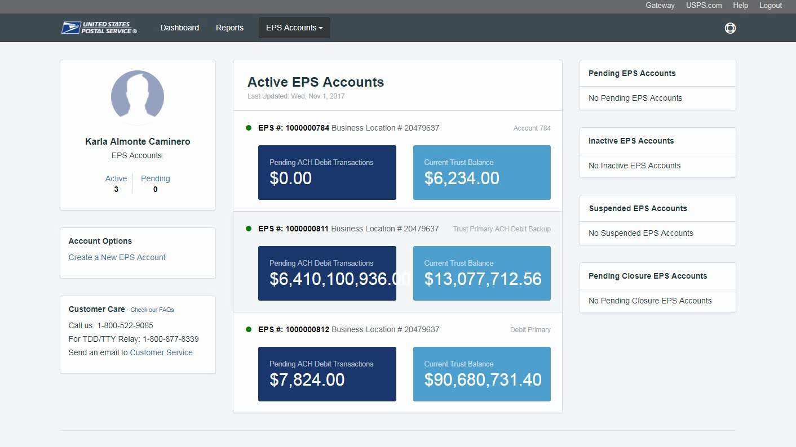
Payment Modernization Walkthrough
In this demo, an EPS Customer will log into their Enterprise Account and be able to view the transactions and reports for their account.
Notes:
4

